Slide 1
Quantum Sensing
For Medical Microwave Imaging
The Sensors
Leo Belostotski, Jerome Bourassa, Brian Jensen, Ming-Tso Wei, Chris Wilson
CDL Quantum Bootcamp Hackathon, 2021

Slide 2
Current Technology
lIMITATIONS
Imaging applications
MRI
Noise/Long Scan Time/Size
Application Limits
Very high cost
X-Ray
Ionizing Radiation/Size
2D Images/Limited Application
Mammograms are unpleasant with high false positive/negative rates
Ultrasound
Expertise/Cannot penetrate bone
Air-filled cavaties problematic
Cardiology
Obstetrics
Ophthalmology
Abdominal Imaging
Cancer detection

Slide 3
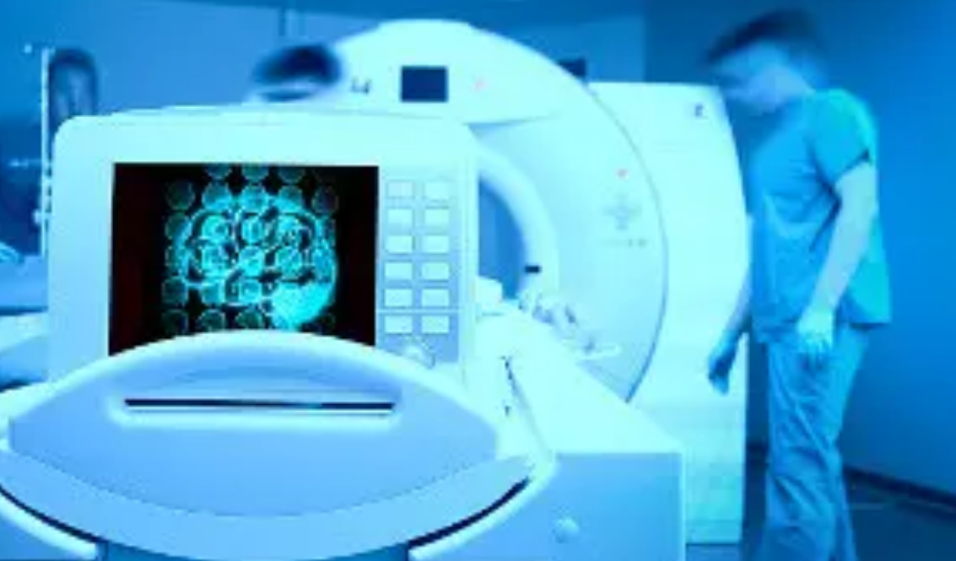
Market Size (by MarketsAndMarkets.com)
26.6 USD Billion in 2021
35.0 USD Billion in 2026
Drivers:
- Rising geriatric population and favorable reimbursements
- Improving healthcare infrastructure in Asia
- Increasing investments funds and grants

Slide 4
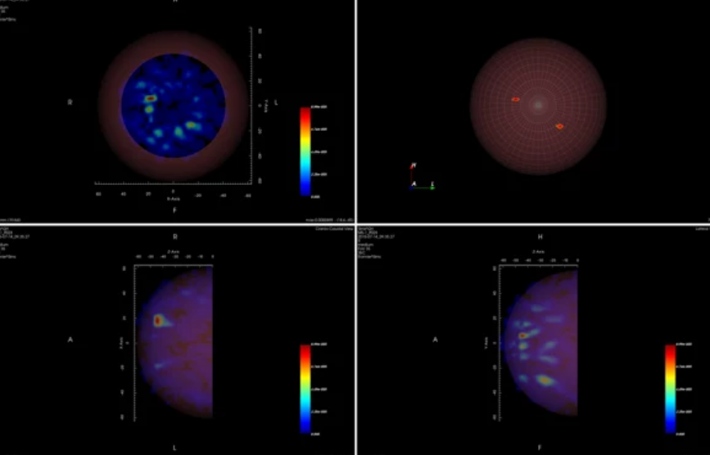
Medical Microwave Imaging
Use microwave scattering to image tissue
Exploits contrast in dielectric and conducting properties of tissue
A number of potential advantages
No ionizing radiation
Potentially images all types of hard and soft tissue
Many components are cheap and off the shelf
Drawbacks
Image reconstruction by a complex inverse problem which is very susceptible to noise

Slide 5
Quantum Solution
Use quantum microwave technology to improve SNR, enabling technology
Microwave source: Squeezed and/or entangled microwave to enhance SNR
Detection: Cryogenic (quantum) amplifiers for better SNR
Detection: Entangled sensor arrays to enhance SNR
Complexity of cryostat is not large compared to competing solutions

Slide 6
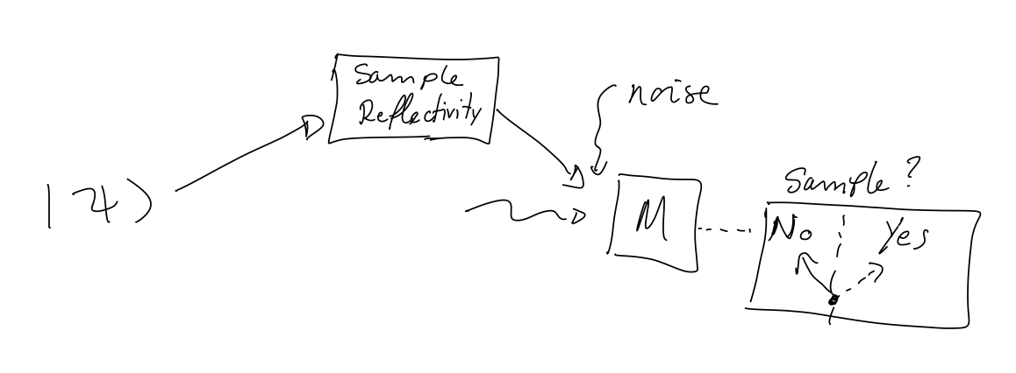
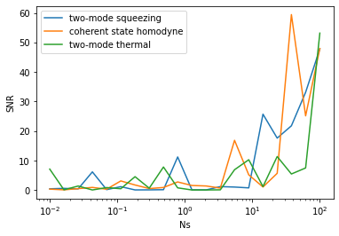
Hackathon Results
Basic Sensing Problem : Sample present or not?
Benchmark different classical and quantum strategies
Simulations with StrawberryFields
Speed-up development process
Results:
Bugs in Gaussian backend
Bosonic : noisy statistics, inconclusive results

Slide 7
Conclusions
Microwave medical imaging: serious vertical for quantum microwave sensing
StrawberryFields + PennyLane high potential for quantum sensor and algorithm development speed-up

